Slide 1
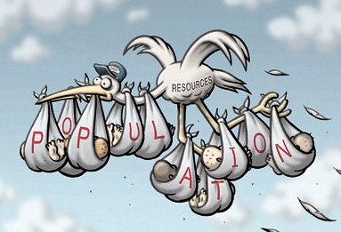
Issues in Using Natural Resources

Slide 2
Environmental Issues

Slide 3
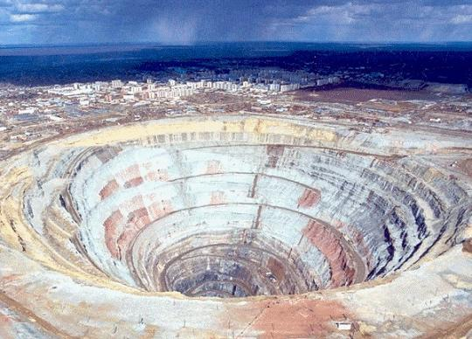
Any mineral extraction causes some environmental impact

Slide 4
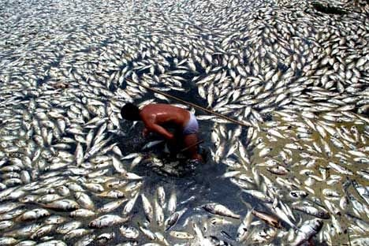
Effluents from any industry may contain potentially harmful chemicals

Slide 5
The importance of caring for the environment first captured public awareness as a result of a famous case of water pollution in Japan during the 1970s.

Slide 6
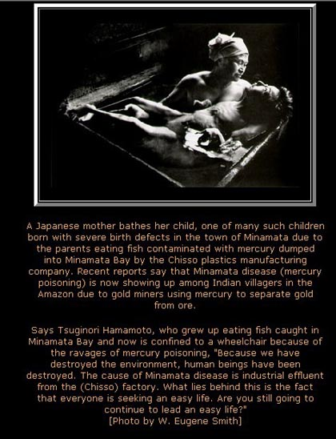

Slide 7
In 1973, a court finally ruled financial compensation for the victims of Minamata Disease. Chisso closed its Minamata operations completely in 1975. The court ruling had cost a lot of money. By then, there were almost a thousand victims of the poisoning. There were another two thousand who sought verification as victims. These people have difficulty swallowing, writing, or buttoning clothes. They may be bent or stiff. Some are afflicted with distorted facial expressions when they speak. Many are dead. Peculiarly, in fetal Minamata disease, the mother is spared because the mercury goes directly to affect the unborn child. The Japanese call environmental and industrial damage "Koga -- public harm.

Slide 8
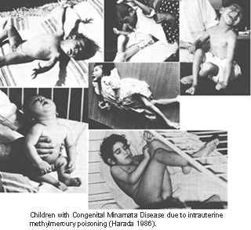

Slide 9
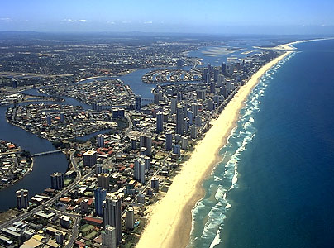
Competing uses
Infilling of wetlands on the Australian Gold Coast
+ for house- and shop owners
+ tourism
- for fishermen
- the ecosystem
- seafood

Slide 10
Energy Use
Almost 20% of world energy comes from renewable sources, and in LEDCs the proportion is much higher.

Slide 11
fuelwood
2 billion people depend on fuelwood
Loss of forest is one of Nepal´s greatest environmental problems
Loss of species and habitats
Global consequences: 2.8 billion tonnes of carbon
Could alter world temperatures
Soil erosion

Slide 12
Solutions
Sustainable rate of logging
Ecotourism

Slide 13
Social and Political Issues
Where will people live if a new resource is remote from settlement?
What will the impact of its transport on communities?
What happens to communities when a resource on which their jobs depend is exhausted or replaced?
What is the impact on groups with less political influence such as ethnic minorities, the poor and women and children?

Slide 14
Management Issues
In practice, the development of more efficient ways to use a resource is the most common conservation measure.
Even if governments see the need to act to conserve a resource, they may be constrained by the voting strength of those who would be affected.
Genuine conservation is usually forced on people, countries and the world.

Slide 15
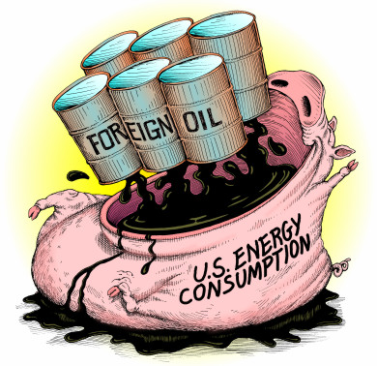
Oil
New Zealand: 80 km per hour speed limit
Weight of the car, aerodynamic, emission control rules, lead-free petrol, more power with less fuel, solar powered cars, electric cars, more combustible – hence more efficient fuel, recycle plastic etc.

Slide 16
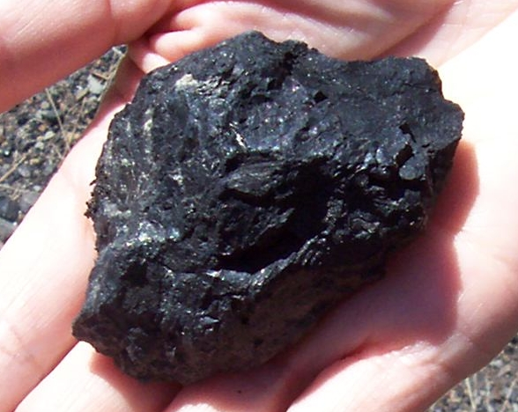
Coal
Conservation (like oil): Find a more efficient way to use it” rather than getting people to reduce their use of the resource.
Less coal used to produce each megawatt of electric power,
but Australia and the US have coal for several thousands of years.

Slide 17
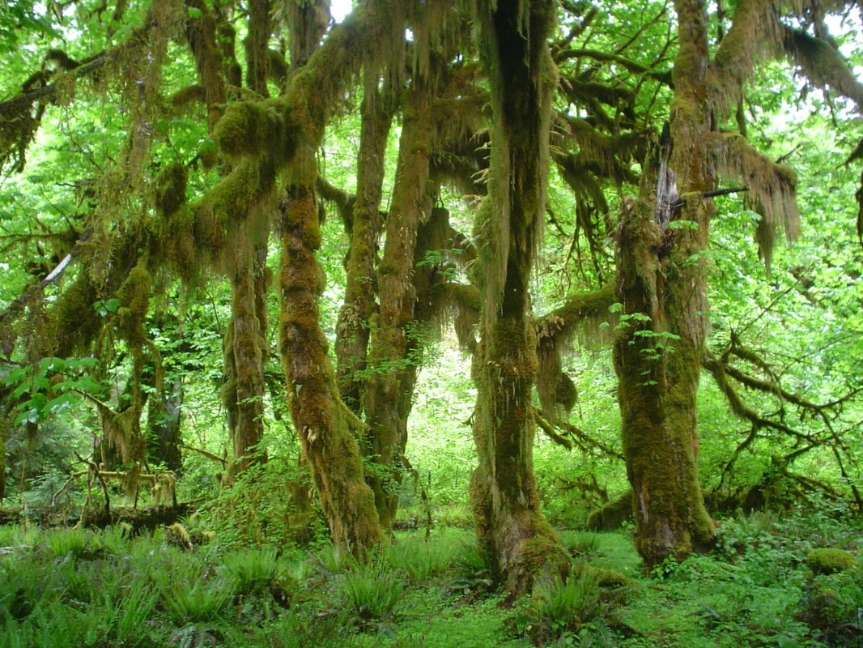
Forests
Saving one’s own forest, exploiting that of others (like Japan and Mitsubishi)
Alternative products
Recycling of paper

Slide 18
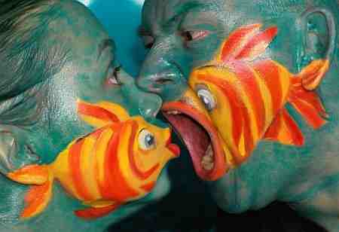
Fish
Size of fish
Bag limit for individual fishers
Adequate patrolling
Problem: Fish may move great distances, dispute over where the 320 km line should go, overlap between countries like the grey zone between Norway and Russia. More efficient fishing techniques (air surveillance, radar devices to locate fish schools). Growing fishing fleets (take quantities that threaten the survival of species). The price that people are willing to pay. Over-exploited as catches have gone down.
Solutions: Marketing small fish for canning and fish-meal, ecotourism whaling.

Slide 19
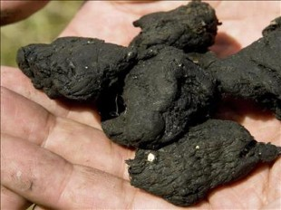
Biomass
Biomass is converted into fuel in a variety of ways, including burning, gasification and anaerobic digestion
Human sewage in China

Slide 20
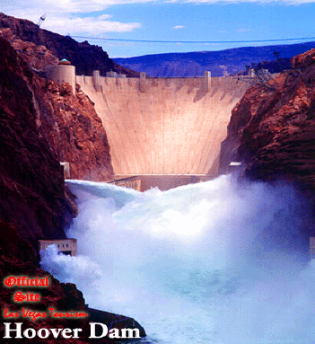
HEP
Clean
High initial cost, then cheap
Flooding of land (Three Gorges Dam on China’s Yangtze River)
Pump-storage dams to supplement coal power stations by recycling water
Most widely used

Slide 21
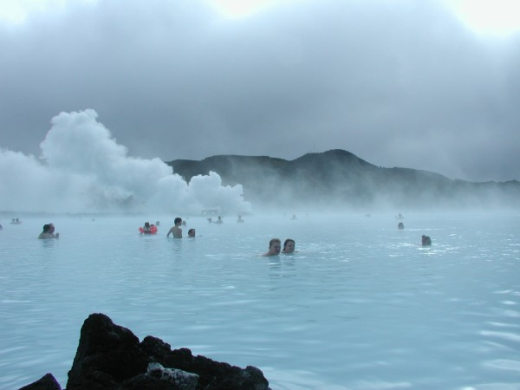
Geothermal
Only in suitable places
The escaping steam often contains other gases such as carbon dioxide and hydrogen sulphide (which is poisonous)
Earthquakes a risk

Slide 22
Wind
80% in three areas in California
Minute proportion of electricity generated even in wind nations
Expensive, then cheap

Slide 23
Tidal
Among the most expensive to build
Interfere with the migration of spawning fish into and out of the coastal estuary

Slide 24
Solar
Clean, safe, expensive, fairly inefficient
Least power when you need it the most

Slide 25
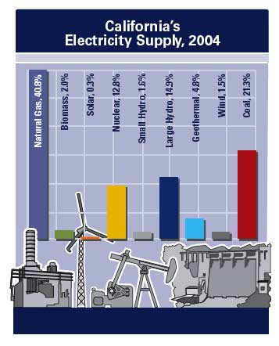

Slide 26
Recycling
Food scraps, animal droppings etc. composted to speed up the bacterial breakdown of the material into soluble plant nutrients
Partial return to the way things were done several generations ago

Slide 27
Paper
Managed, replacement forests (eucalypt all over the world)
Grey paper (reduce the toxic effluents)
Sorting in LEDCs
Paperless office no success

Slide 28
Water
Egypt – reliable flow of the Nile
Myanmar did not want piped water
More work must be done on how to re-use water (Australia versus London)
Re-direct grey water (from baths, washing)
Steep rises in pricing
Restrictions to effluents from mining and industry with heavy fines (treatment on-site)
Must become better at preventing water from being polluted in the first place and more ready to pay for the treatment. (Al Gore, water wars – Egypt)

Slide 29
Water Use near the Aral Sea – A Case Study in Natural Resource Management
Border of Kazakhstan and Uzbekistan
The air is very dry
Hot, dry winds
Sandy soils do not retain moisture
Salty soils

Slide 30
Once the world's fourth largest lake, the mighty Aral Sea is now in it's death throes. Starved of it's lifeblood of the waters of the Syr Darya and the Amu Darya rivers, the sea has been shrinking for the last 40 years.
From the 1930s, the former Soviet Union started building large scale diversion canals to irrigate vast cotton fields in a grand plan to make cotton a great export earner. This was achieved, and even today Uzbekistan is still a large exporter of cotton. But the cost in ecological and human terms have been astronomical.

Slide 31
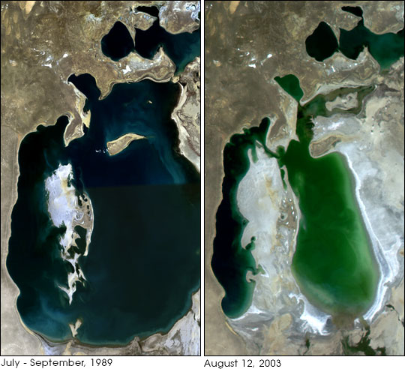

Slide 32
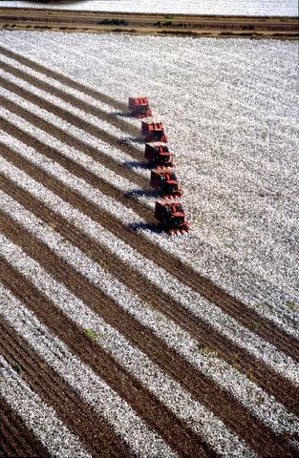
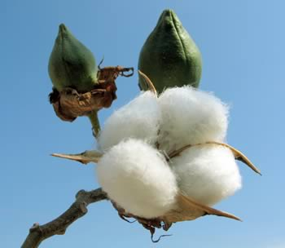
Cotton

Slide 33
