Slide 1
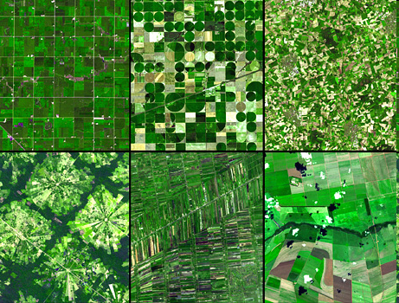
Minnesota USA
Kansas USA
North west Germany
Introduction to Agriculture
Santa Cruz Bolivia
Thailand
Brazil

Slide 2
Key questions
What is agriculture?
Why do we study it?
How can farming and agriculture be classified?
How can a systems approach help us with this classification?
What are the characteristics of small and large-scale farms?

Slide 3
Classifying Agriculture
Task – use the following slides and p196-197 geog.GCSE to write definitions for the following types of agriculture

Slide 4
Classifying Agriculture
Subsistence and commercial

Slide 5
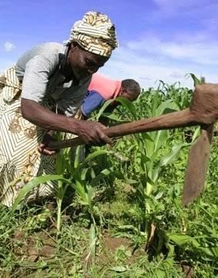
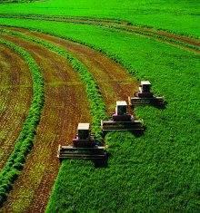
Subsistence farming Commercial farming.
Most of the world’s farmers are women, especially in areas of subsistence farming

Slide 6
Classifying Agriculture
Shifting (nomadic) and sedentary

Slide 7
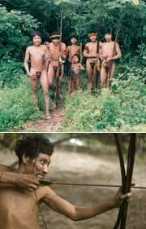
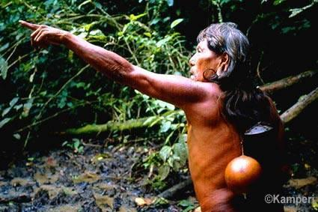
For most of human history we have been hunter gathers. In the Neolithic Revolution 12000 years ago we started farming (domesticating animals and planting seeds)
There are still tribes who are hunter gatherers. They rely on a highly developed knowledge of their natural environment. This is an example of shifting cultivation.

Slide 8
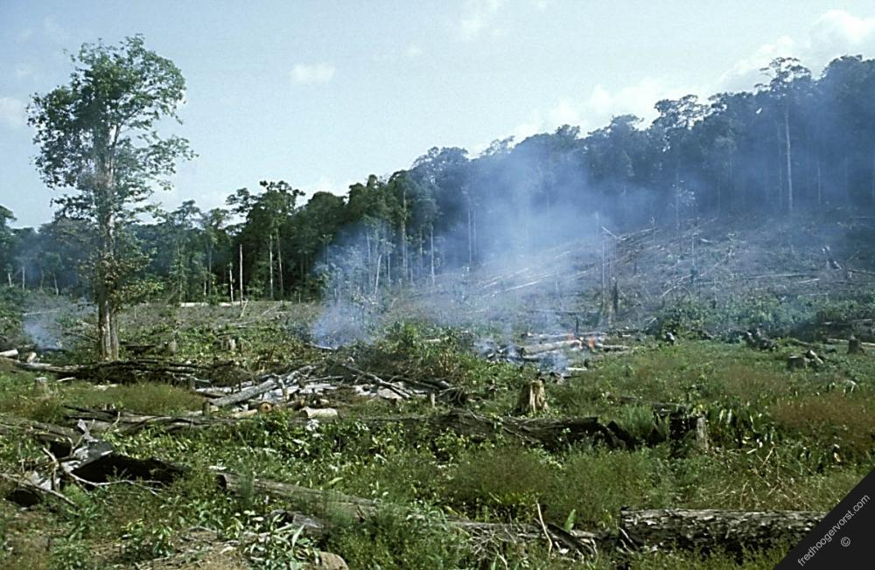
Clearing trees for a small subsistence farm - the land will be farmed for a few years and then the farmers will move on to a new area - shifting cultivation

Slide 9
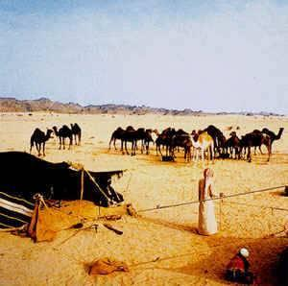
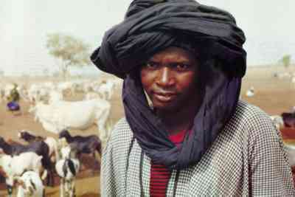
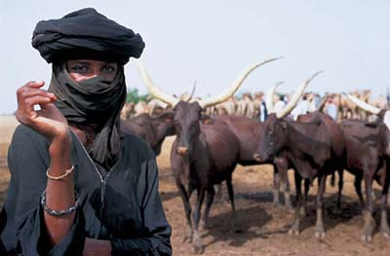
Nomadic farmers will move their cattle to follow the rains. This is another example of shifting cultivation.
Remember the seasonal migration of pressure belts? This is an example of human adaptation.

Slide 10
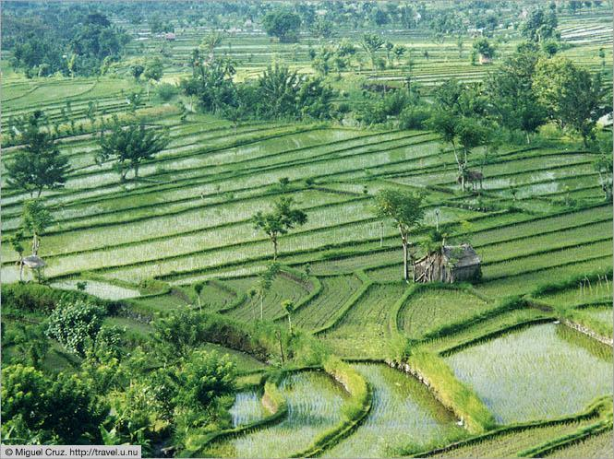
Rice growing - an example of sedentary agriculture

Slide 11
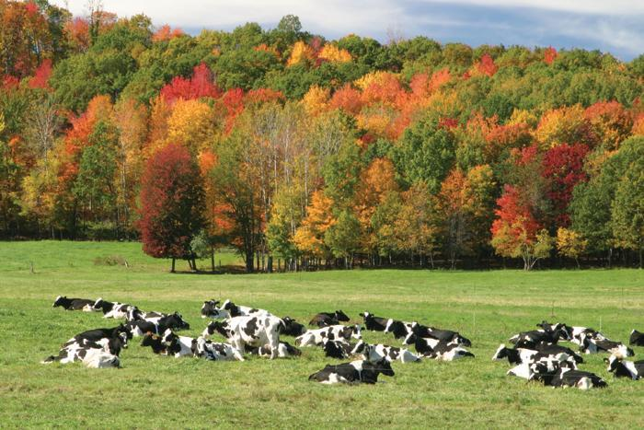
Cows resting in a field - sedentary agiculture

Slide 12
Classifying Agriculture
Arable and pastoral farming

Slide 13
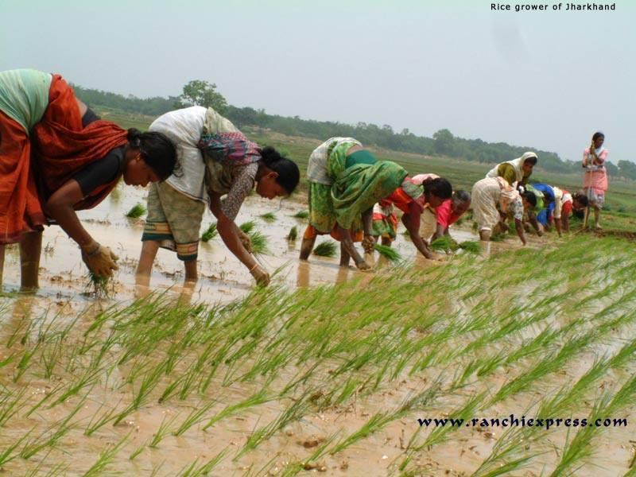
Rice is an example of arable farming. In Asia rice is one of the staple crops and it feeds a huge percentage of the world population in countries like India and China.

Slide 14
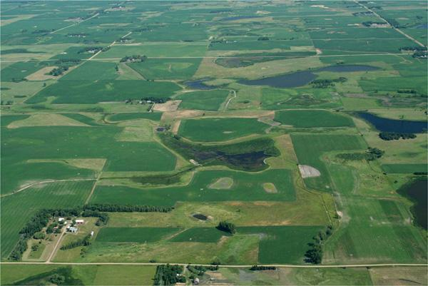
Mixed farm - arable crops grown and also animals reared (pastoral)

Slide 15
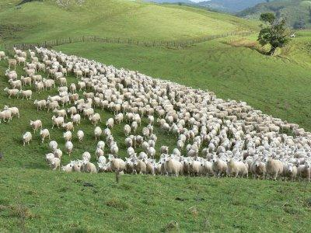
A flock of sheep - an example of pastoral farming.

Slide 16
Classifying Agriculture
Dairy and market gardening

Slide 17
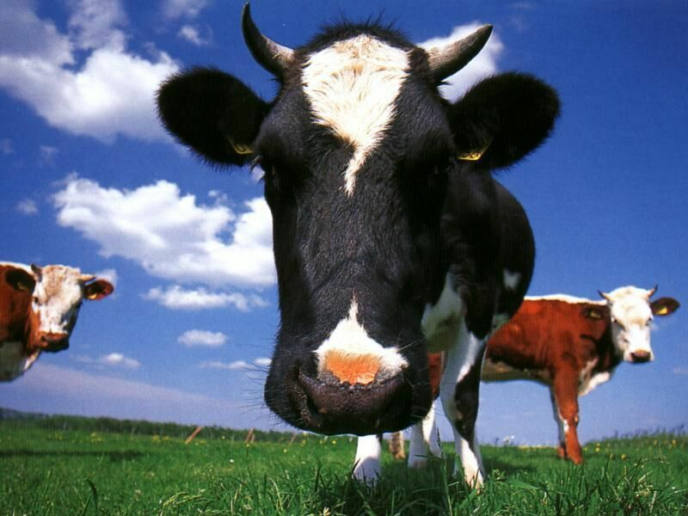
Dairy farming – this is an example of pastoral farming. Which type of farming do you think is more efficient, arable or pastoral?

Slide 18
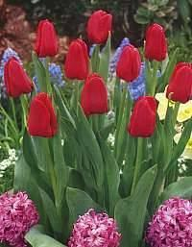
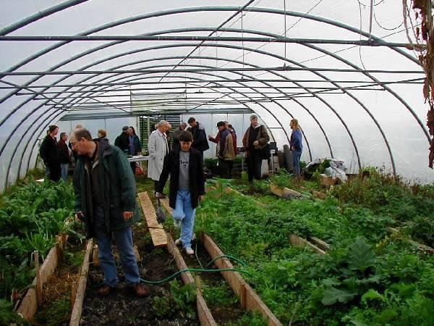
Market Gardening
Intensive cultivation of high value products, like flowers or specialist plants

Slide 19
Classifying Agriculture
Intensive and extensive

Slide 20
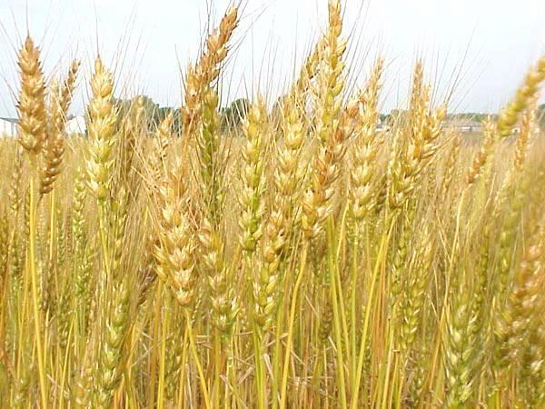
Wheat – this is arable and an example of intensive farming with many expensive inputs.

Slide 21
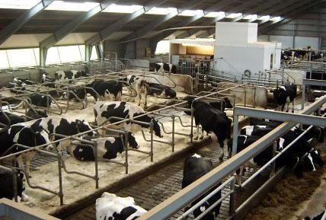
A modern dairy farm - an example of intensive farming with a lot of capital input into a relatively small farm

Slide 22
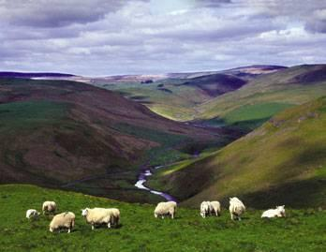
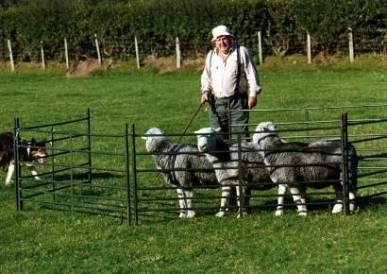
Sheep farming – extensive agriculture with low inputs spread over a large area. Producing relatively low value products

Slide 23
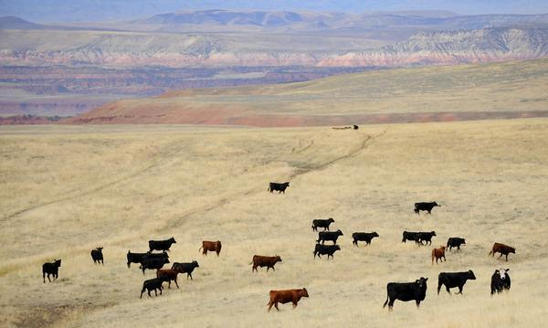
Cattle ranch - extensive farming over a large area with small inputs of labour and machinery

Slide 24
USEFUL KEY WORDS
Task – write a definition for each of these useful agricultural words…
yield, harvest, crops, livestock,
Genetic Modification (GM),
cross breeding,
High Yield Varieties (HYV),
pesticides, herbicides, fertilizer, eutrophication irrigation,
organic, cash crops,
hectare, drought,
Green Revolution.

Slide 25
The Systems Approach
Inputs
Processes
Outputs
Feedback
TASKS
What are physical inputs?
What are human inputs?
Use p.195 ‘geog. GCSE’ to briefly list and explain the effect of each input on a named farm product.
What are the processes?
What are the outputs?
Use p.195 ‘geog. GCSE’ to briefly list.

