Slide 1
POPULATIONS IN TRANSITION

Slide 2
Population change

Slide 3
definitions

Slide 4
Crude birth rate
The average number of births per thousand of population per year.

Slide 5
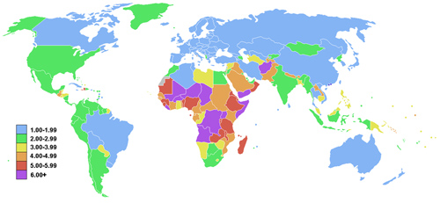
Fertility rate
Interesting article, stating that as a country gets very developed, the fertility rate might start going up again, like in Norway from 1.7 to 1.8.
The average number of children per woman. Interesting article, stating that as a country gets very developed, the fertility rate might go up again.

Slide 6
Infant mortality rate
The total number of deaths of children less than 1 year old per thousand live births per year.

Slide 7
Child mortality rate
The total number of deaths of children aged 1 to 5 years per thousand children aged 1 to 5 per year.

Slide 8
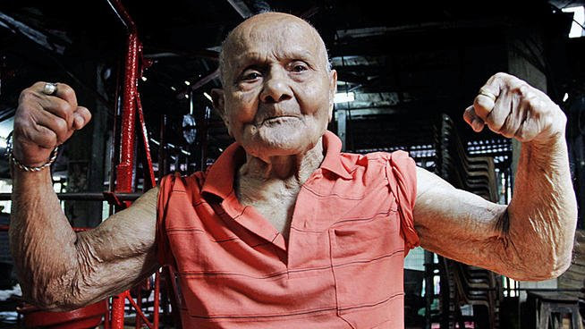
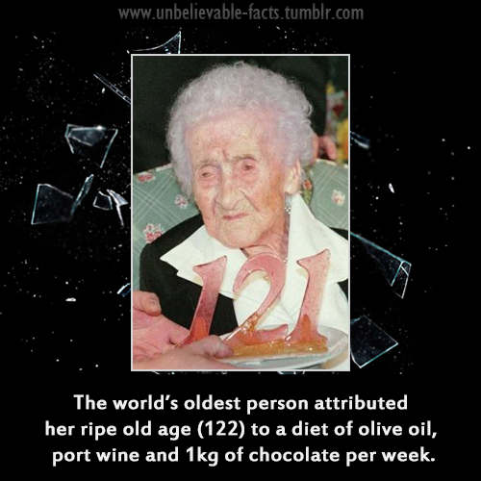
Life expectancy
The average number of years that a person can be expected to live, given that demographic factors remain unchanged.

Slide 9
Dependency ratio
The proportion of the population aged under 15 and over 65 (the economically dependent) relative to the proportion of the population aged 16 to 65 (the economically active).

Slide 10
Population momentum
The tendency for a population to grow despite a fall in fertility levels because of a relatively high concentration of people of childbearing or pre-childbearing age.
(It is also the tendency for a population to continue to fall despite a rise in the birth rate).
(= the time lag between a change in birth/death rates and the slowing of population growth or rise in population).

Slide 11
Migration
The movement of people, involving a change of residence. It can be internal or external (international) and voluntary or forced. It does not include temporary circulations such as commuting or tourism.

Slide 12
Explain population trends and patterns in births (crude birth rate), natural increase and mortality (crude death rate, infant and child mortality rates), fertility and life expectancy in contrasting regions of the world.

Slide 13
You should know how each of these indicators is determined, be able to describe and give reasons for the trends (changes over time) that have occurred in world regions that contrast in terms of development. For example, you should know statistics for all indicators for contrasting regions and should be able to give at least one example of a country within each region. You should be able to recognize population patterns and explain them. A common error is to assume that high birth rates of natural increase are explained by high birth rates alone.
Remember that it is the relationship between birth rate and death rate that determines natural increase, while the relationship between birth rate, death rate, immigration and emigration determines population change.

Slide 14
 | Crude birth rate | Natural increase (2011) | Crude death rate | Infant mortality rate (per 1000 live births) | Child mortality rate (2011) | Fertility rate | Life expectancy
Norway | 11/1000 | 0.4% | 9/1000 | 4/1000 | 3/1000 | 1.8 | 80
Zambia | 43/1000 | 3.1% | 13/1000 | 69/1000 | 83/1000 | 5.8 | 52
(Rate of natural increase is the birth rate minus the death rate, expressed as a percent or per 1000).

Slide 15
Analyse population pyramids

Slide 16
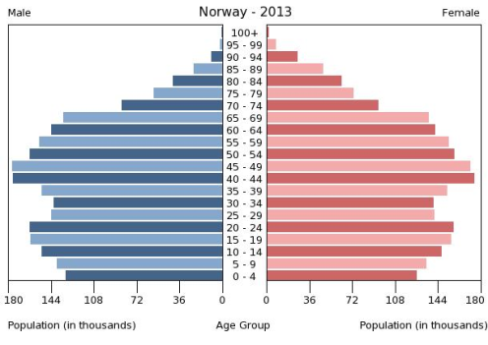
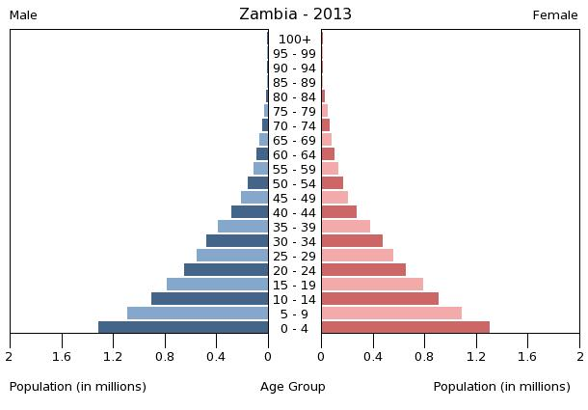
You should be able to draw two contrasting pyramids and show their development over time.
Features such as the influx of immigrants, the impact of birth-control policies and gender imbalances could all be explained through annotations on a population pyramid.

Slide 17
Explain dependency and ageing ratios

Slide 18
Dependency ratios are found by calculating the proportion of young and/or elderly people relative to the working population.
(“The proportion of the population aged under 15 and over 65 (the economically dependent) relative to the proportion of the population aged 16 to 65 (the economically active)”.

Slide 19
Examine the impacts of youthful and ageing populations.

Slide 20
You should be able to explain both positive and negative socio-economic impacts for both ageing populations and youthful populations.

Slide 21
Advantages/disadvantages of a youthful population – Page 12 in IB Course Companion, example Zambia (median age 17), Uganda (median age 15).
Advantages/disadvantages of an ageing population – Pages 12-14 in IB Course Companion, examples Japan (median age 46), Norway (median age 41).
Geography Base

Slide 22
Evaluate examples of a pro-natalist and an anti-natalist policy.

Slide 23
Anti-natalist policy
Case studies: China (pages 14-15 in IB Course Companion, PPT, Kerala in India (handout).
Geography Base (1.2: China).

Slide 24
Pro-natalist policy
Case studies:, France (Geography All the Way), Singapore (Geography Base, handout), Romania (IB CC, pages 15-16).

Slide 25
Discuss the causes of migrations, both forced and voluntary.

Slide 26
Evaluate internal (national) and international migration in terms of their geographic (socio-economic, political and environmental) impacts at their origins and destinations.

Slide 27
Bear in mind that you need to have selected case studies that fulfill these requirements and that give the topic its broadest interpretation. This means looking at migrations with different motives, on different scales and with a range of impacts, which may be positive or negative and long or short term. Your case studies should not be confined to the rich world because both internal and international movements have profound socio-economic effects in the poor world.

Slide 28
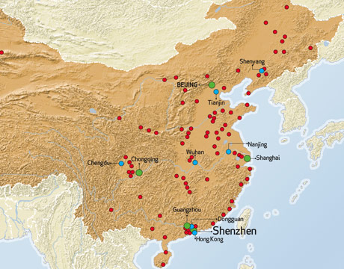
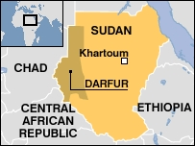
Case studies: International migration (Mexicans to the USA, Geography All the Way, your own sheet), internal migration (rural-urban migration in China, sheet), forced migration (Darfur, page 23 in IB CC, your own notes).

Slide 29
Examine gender inequalities in culture, status, education, birth ratios, health, employment, empowerment, life expectancy, family size, migration, legal rights and land tenure.

Slide 30
Geography Base
The implications here is that the status of women is inferior, although it is not specified. You should explain the origins of inequality, its consequences, and any attempt to achieve a balance of opportunities. In order to cover all aspects of gender inequality listed here, you should select two countries with marked cultural contrasts. For example, one selected from the Middle East, where gender inequality is still an issue, and one selected from northern Europe. You should know some appropriate statistics, such as the gender gap index.

Slide 33
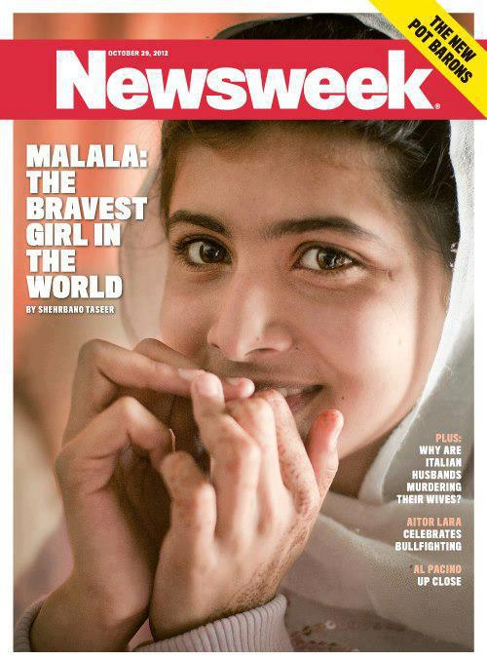
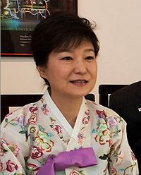
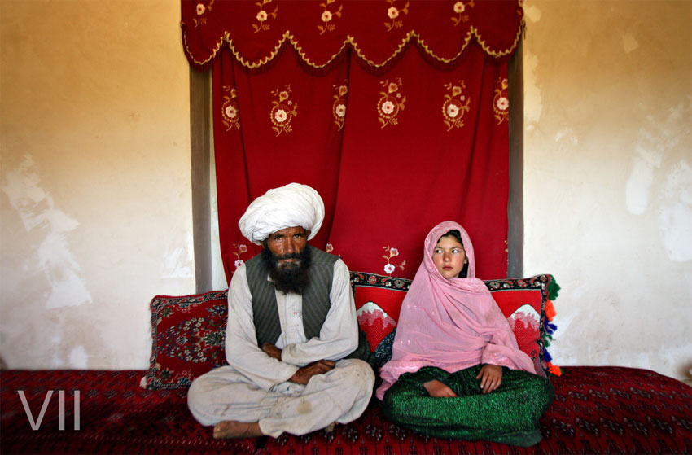
India
Similar quotas have been passed in 20 sub-Saharan nations, six of which top the world in female representation. Rwanda is number one, with 56 percent of seats in Parliament held by women. These figures put African countries well ahead of the United States, France and Japan, which are just at or fall below the 19 percent mark.
Pakistan
Park Geun-hye since 25 February 2013
President of the Republic of Korea

Slide 34
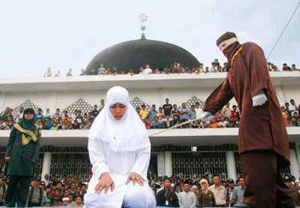
15-year-old rape victim in the Maldives stepfather sex outside marriage

Slide 36
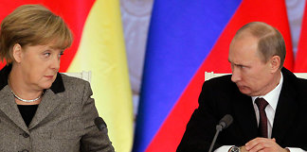

Slide 37
Norway tops gender gap index, Yemen ranked worst.

